Slide 1

ADVENTURE WORKS

Slide 2

DATA ANALYTICS P – 697 Group - 4
Ughade Adesh Rajendra
Sambathina Dhamanidhi
Shital Sonare
Collins Deva Prasad

Slide 3

Sales performance
Customer behavior
Product profitability
Sales trends
Customer demographics
Product categories
Regional performance
Problem Statement
Scope Of Analysis

Slide 4

Sales performance
Customer behavior
Product profitability
Sales trends
Customer demographics
Product categories
Regional performance
Problem Statement
Scope Of Analysis

Slide 5
DATA MODELING
DATA CLEANING
Customer
Sales
DATA GATHERING
Product
Sub category
Category
Territory
DATA EVALUATION
CLEANING OF DATA
VERIFICATION OF DATA

Slide 6
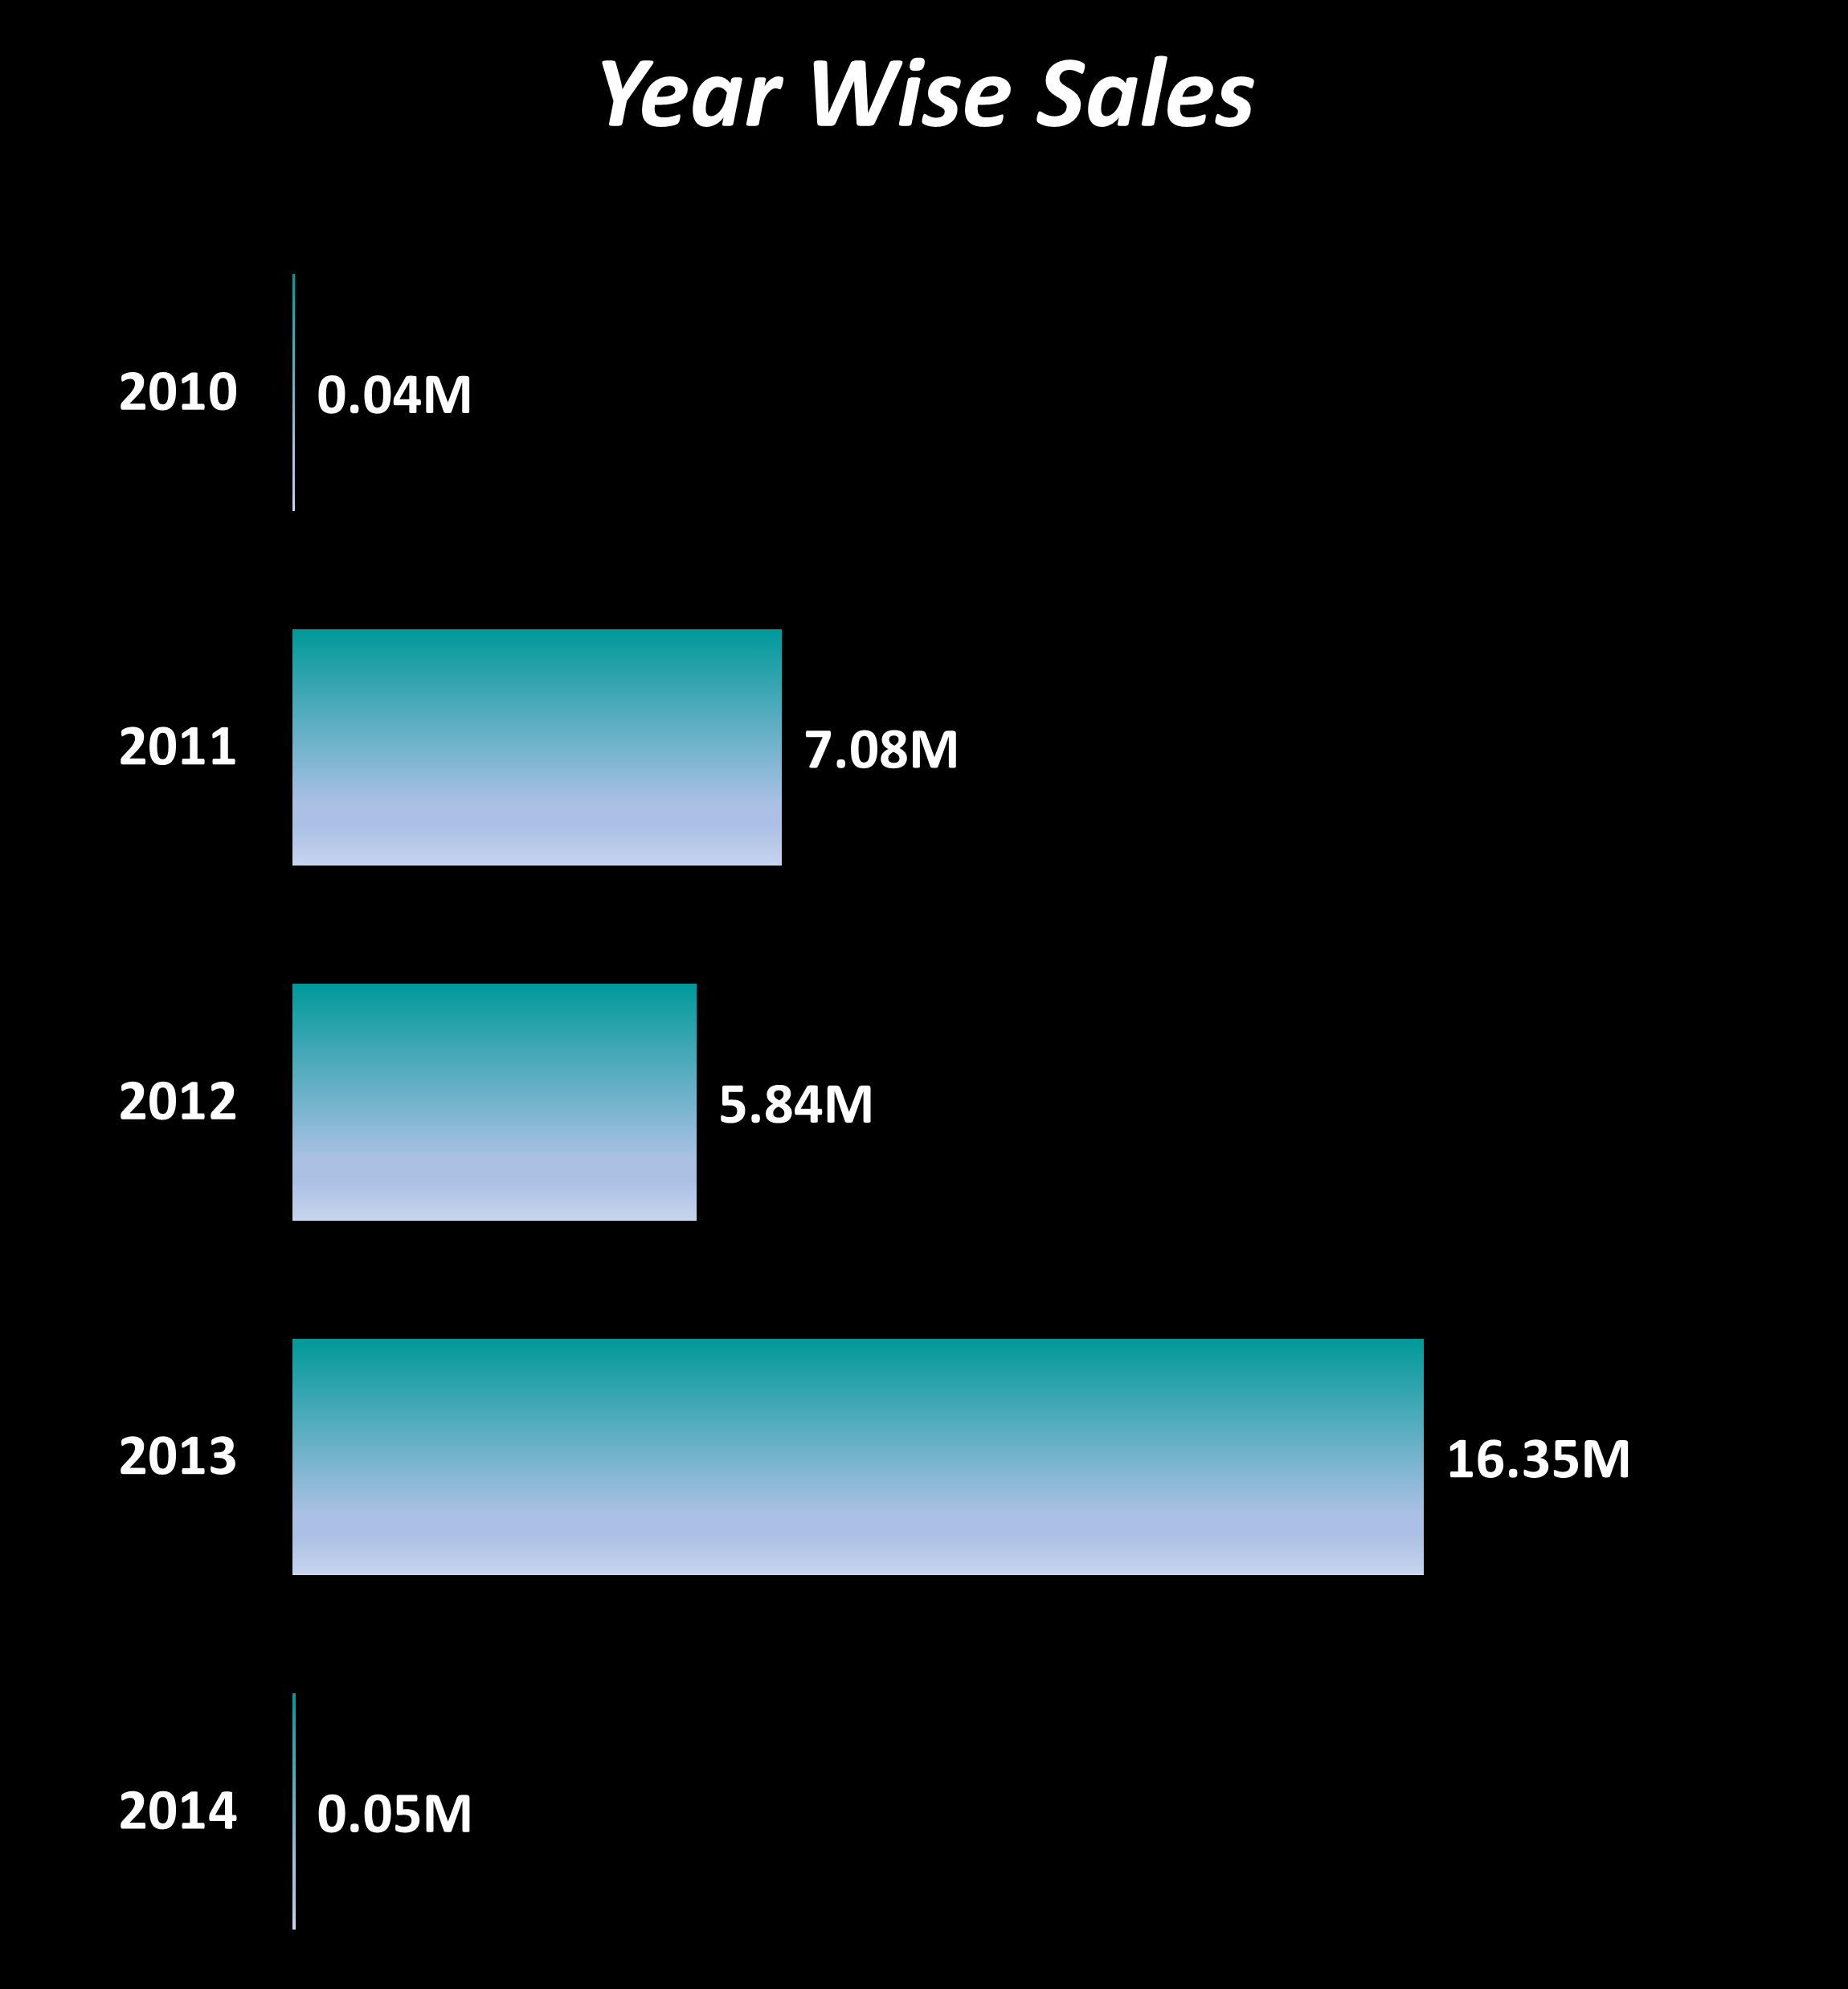
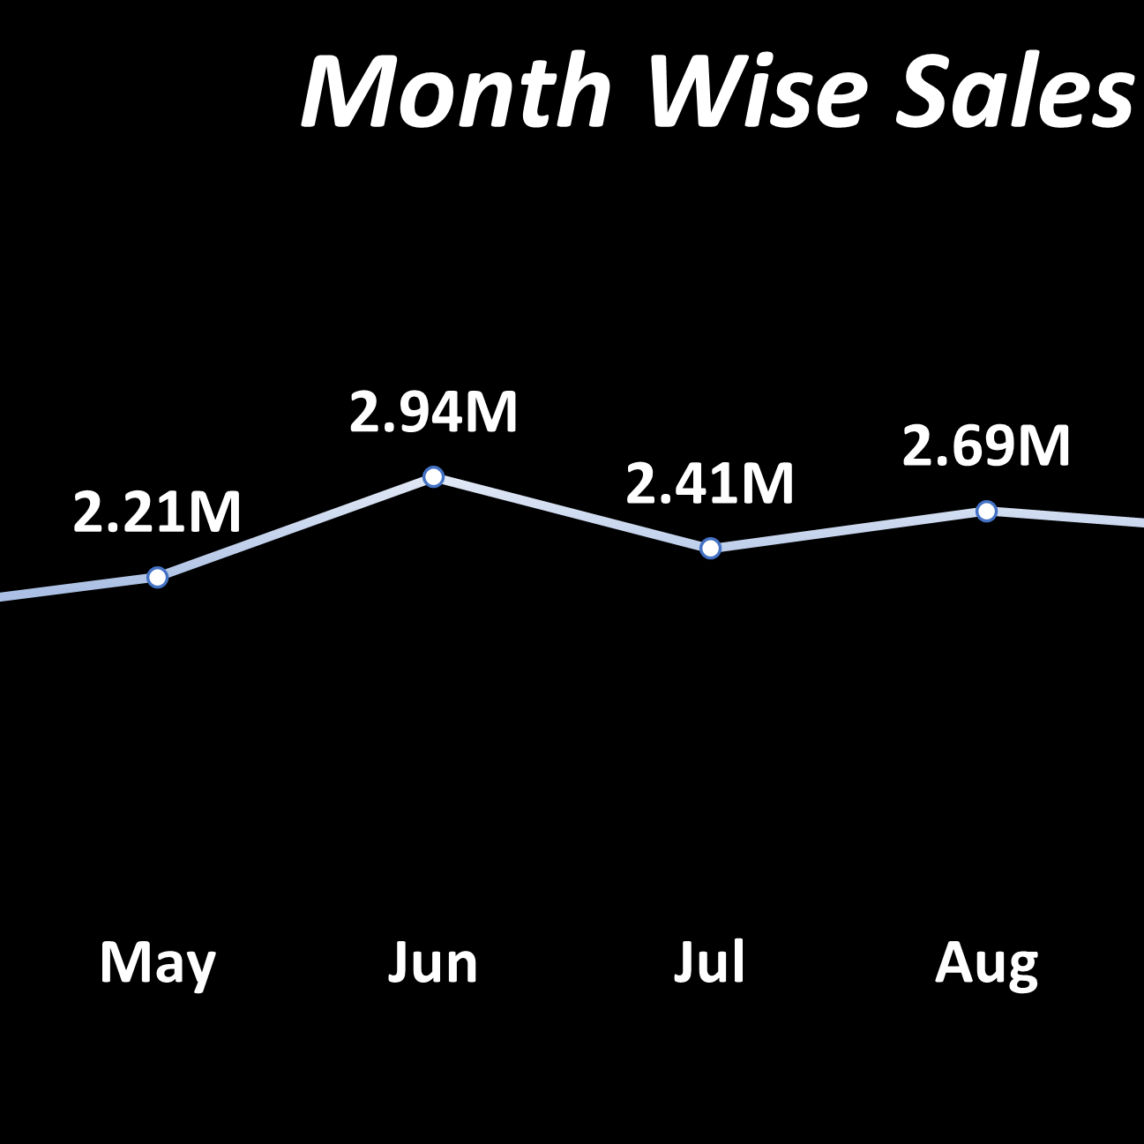
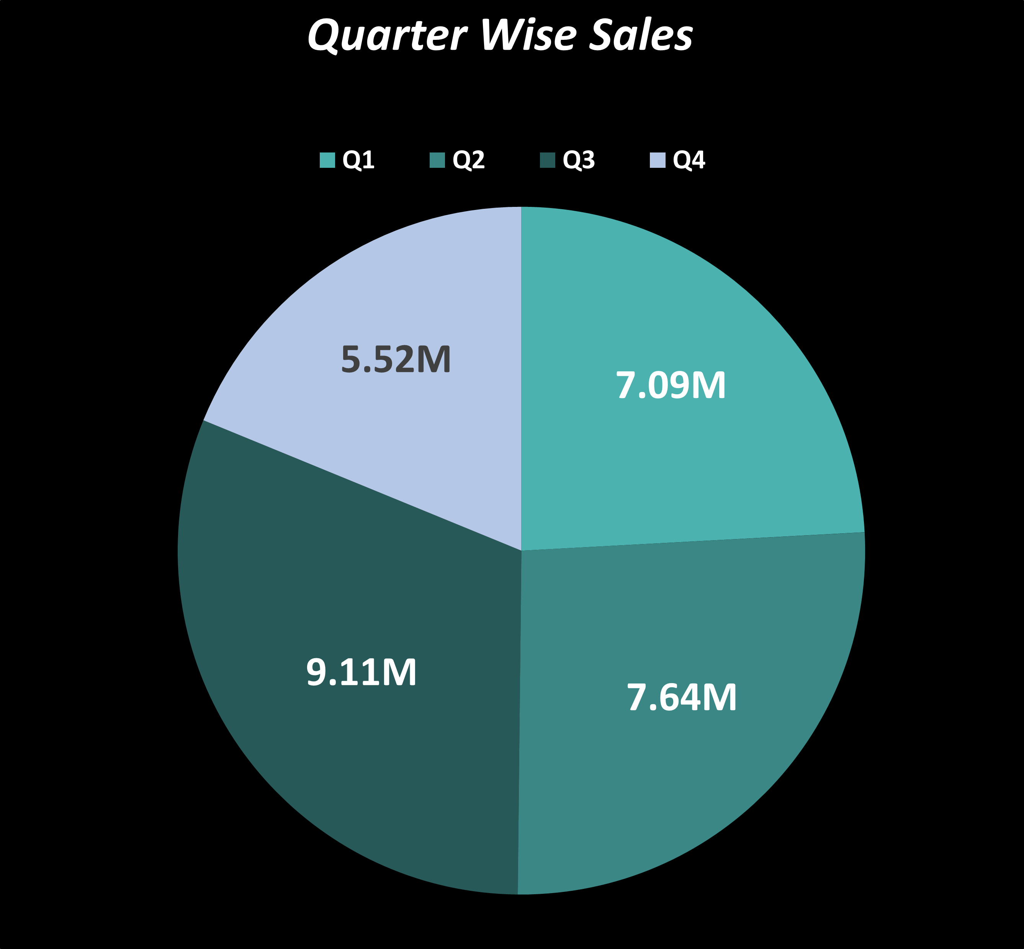
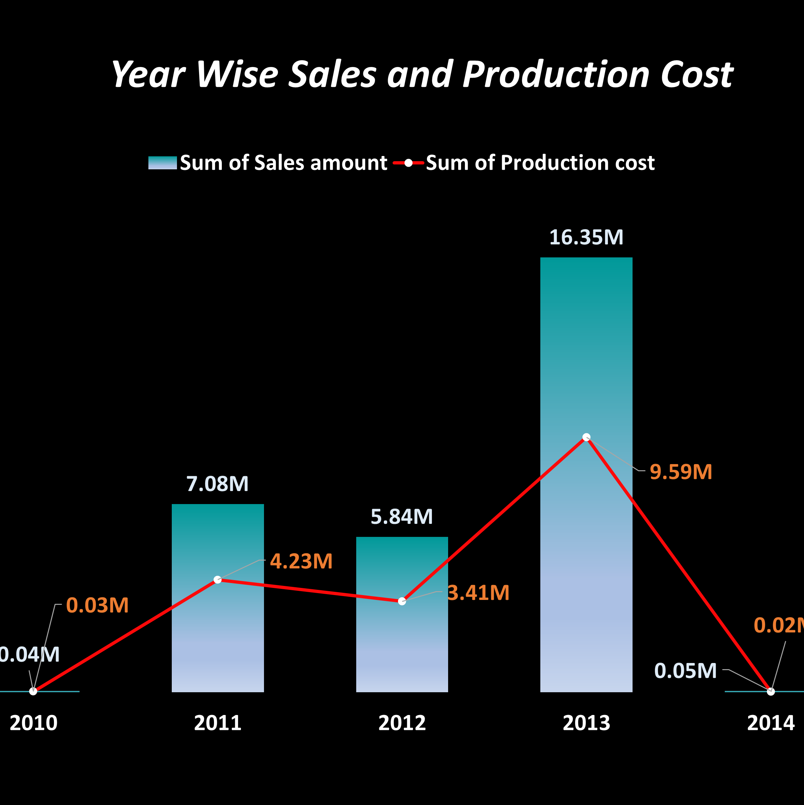
Insights
Steady increase from 2010 to 2013 , peaking at 16.35M in 2013
Declining to 0.05M in 2014
Strategies
Further investigation into market conditions and operational strategies in 2014

Slide 7
Insights
December has the peak sales month, contributing 3.21M
February has the least sales month, contributing 1.74M
Strategies
Capitalizing on year-end opportunities through targeted marketing and inventory strategies

Slide 8
Insights
Q3 is the strongest quarter, generating 9.11M, followed by Q4 at 7.64M
Strategies
Optimize quarterly strategies, particularly for Q3 to maximize profitability

Slide 9
Insights
2013 was a year of maximum profitability, with a noticeable gap between sales and production costs
Strategies
Detailed market analysis post 2013

Slide 10

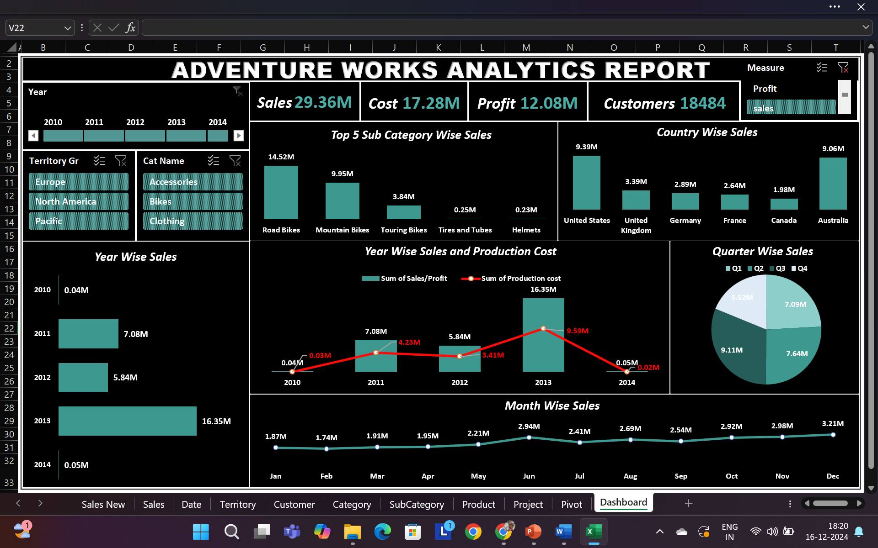
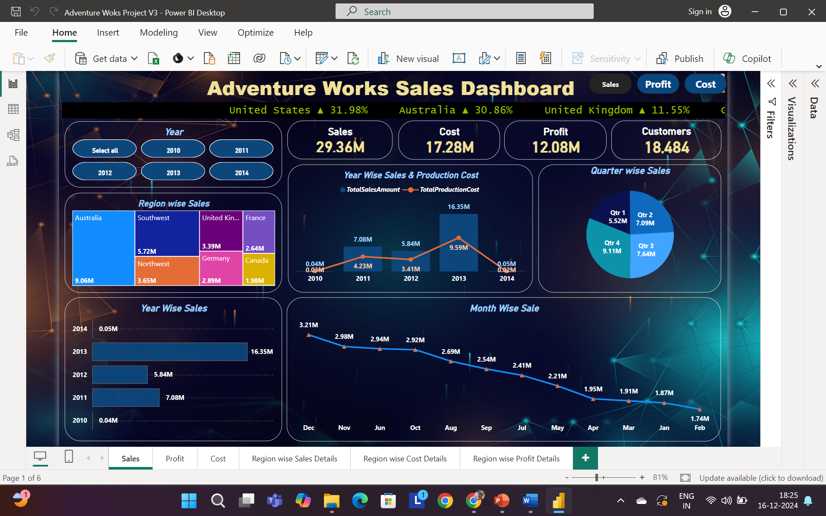
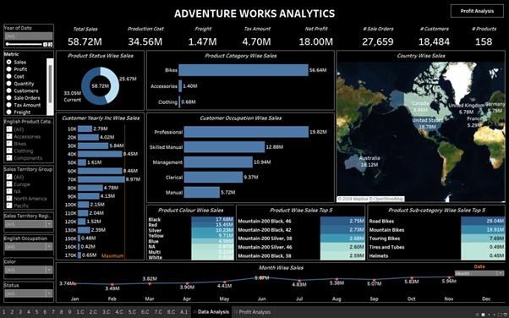
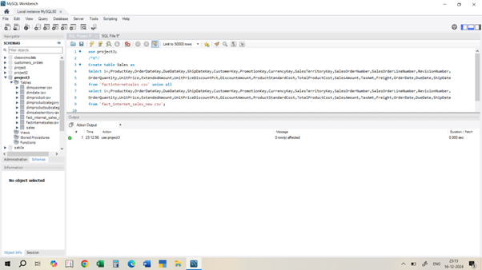




1
1
1
1

Slide 11
1
1
1
1

Slide 12
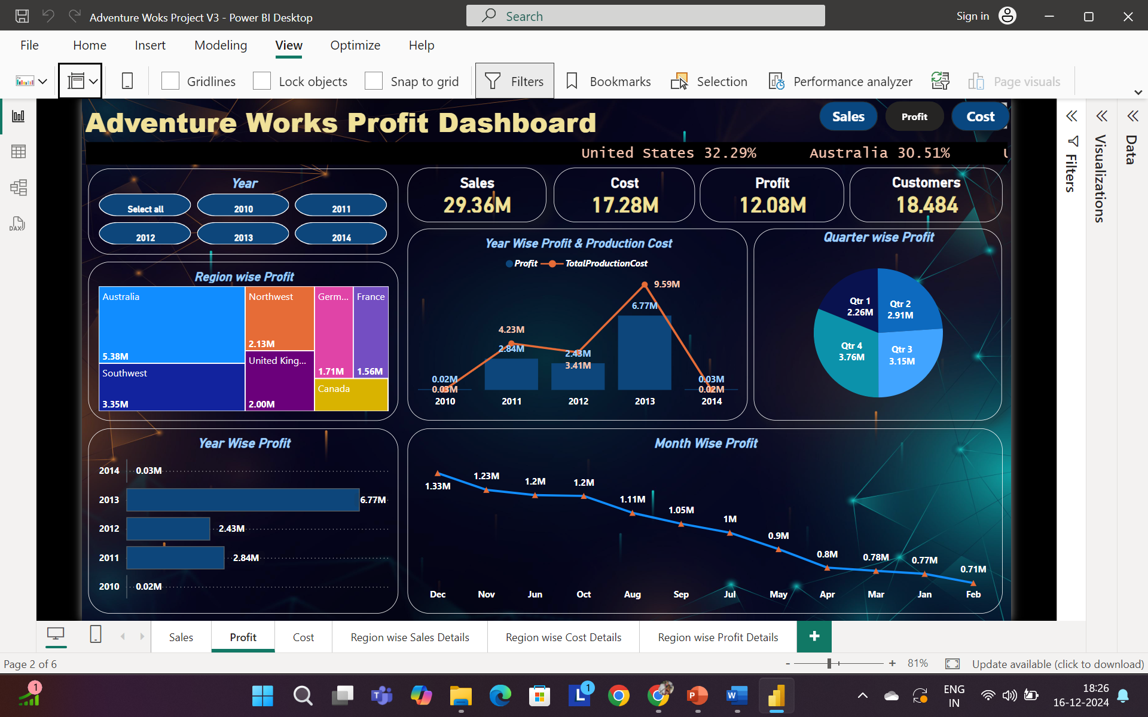
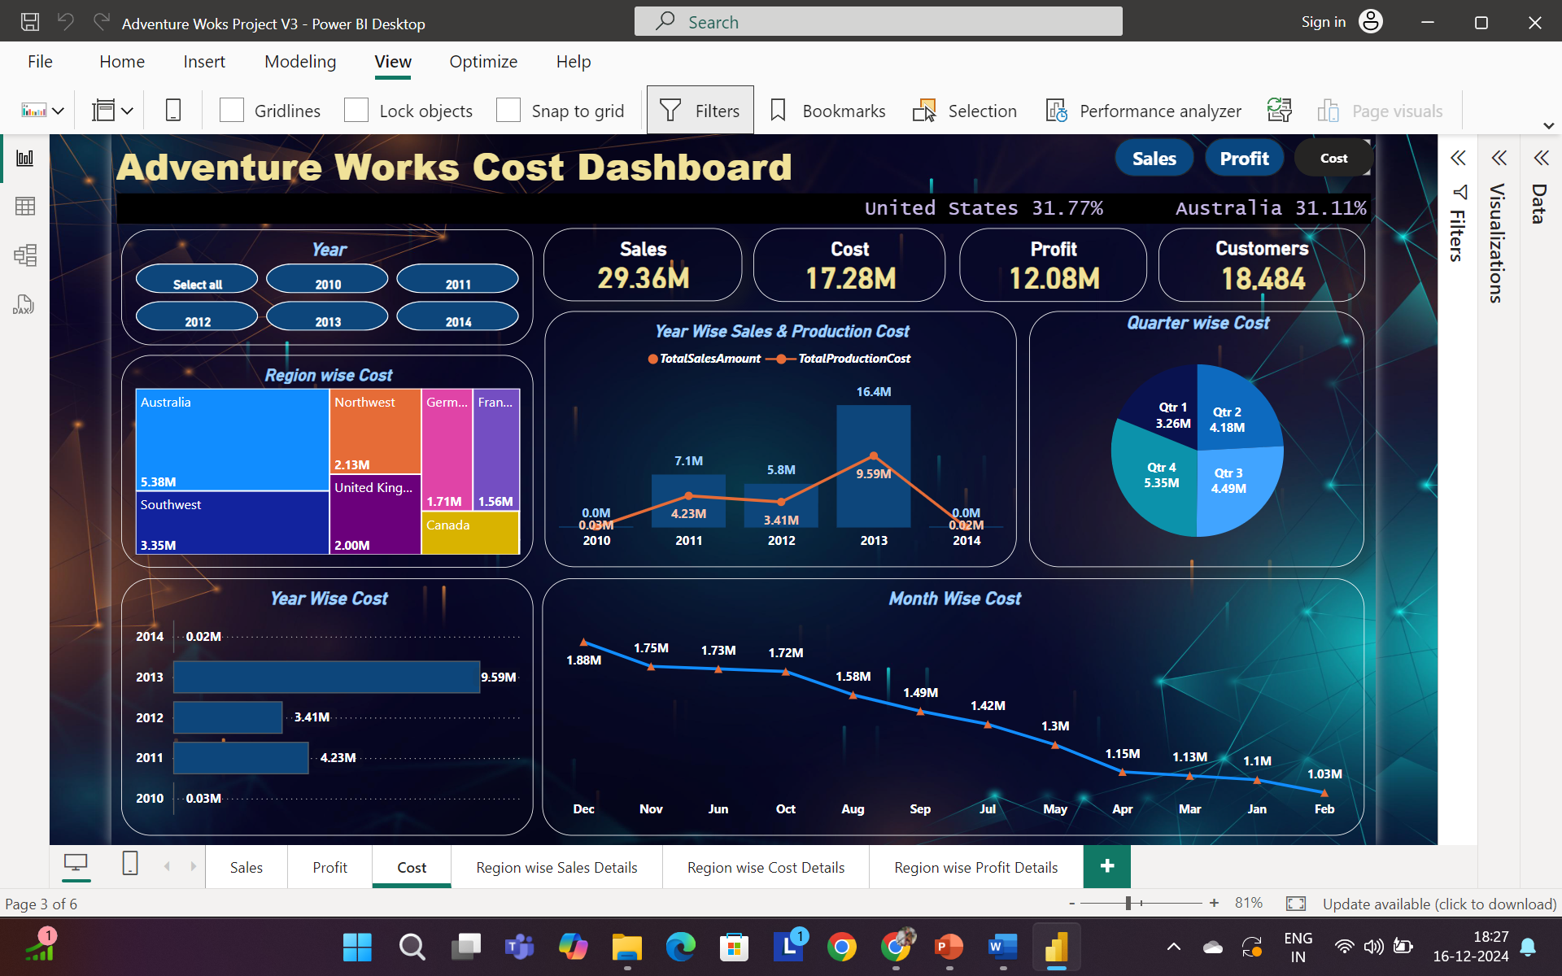
1
1
Sales
Profit
Cost
1
1

Slide 13
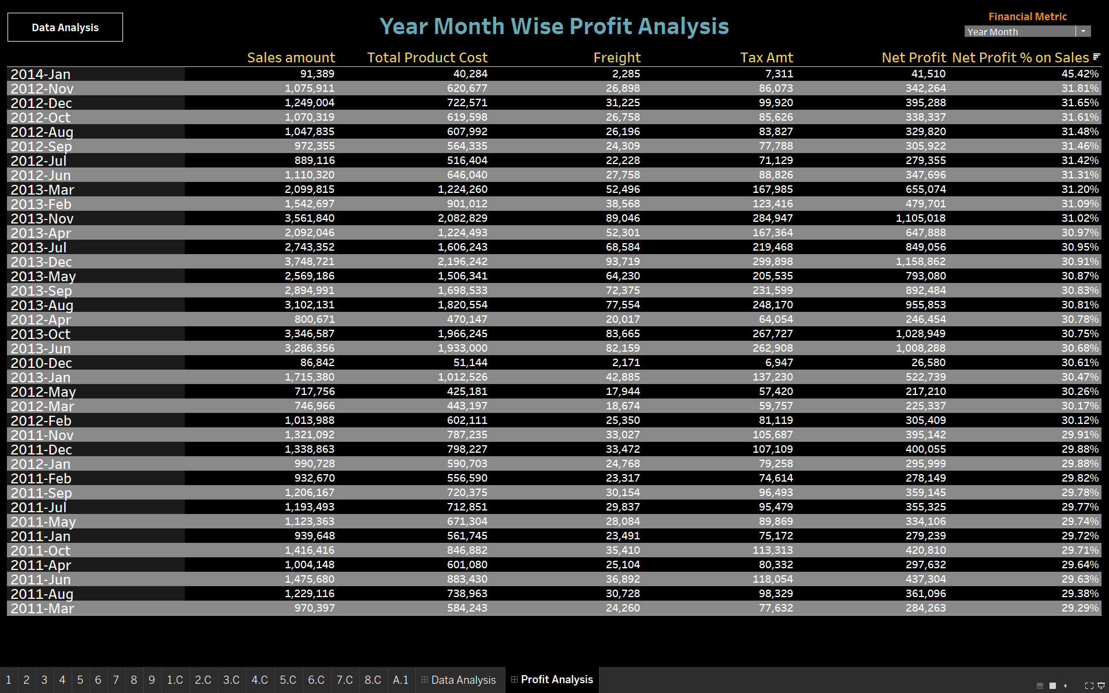


1
1
DATA ANALYSIS
1
PROFIT ANALYSIS
1

Slide 14
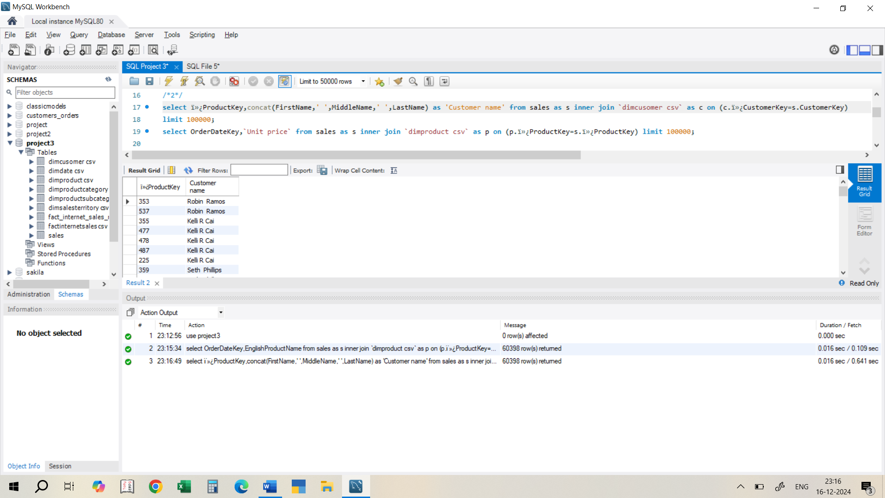
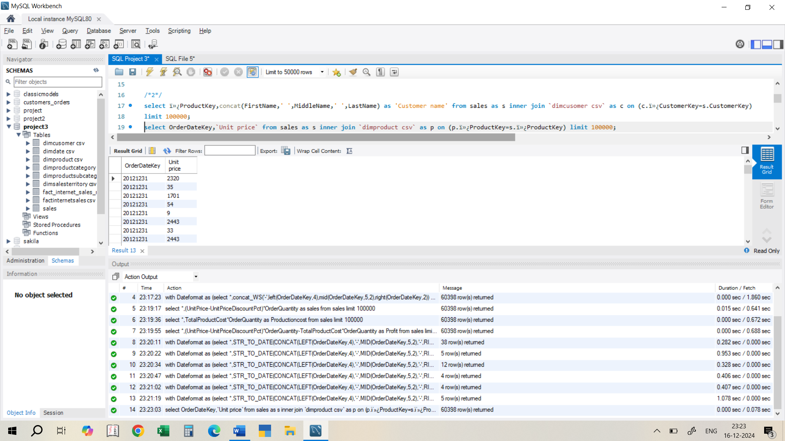
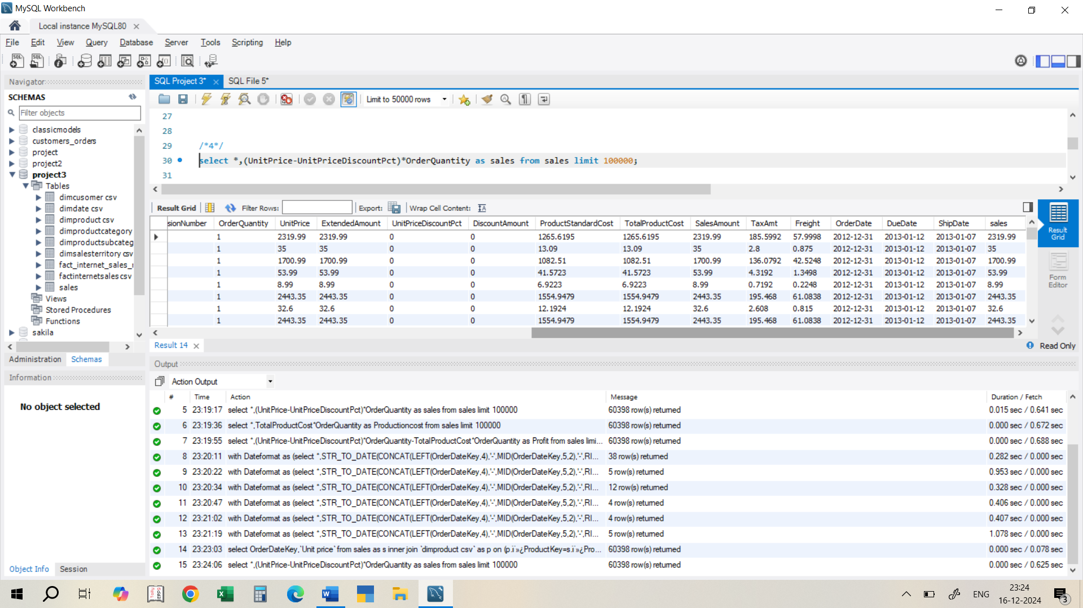
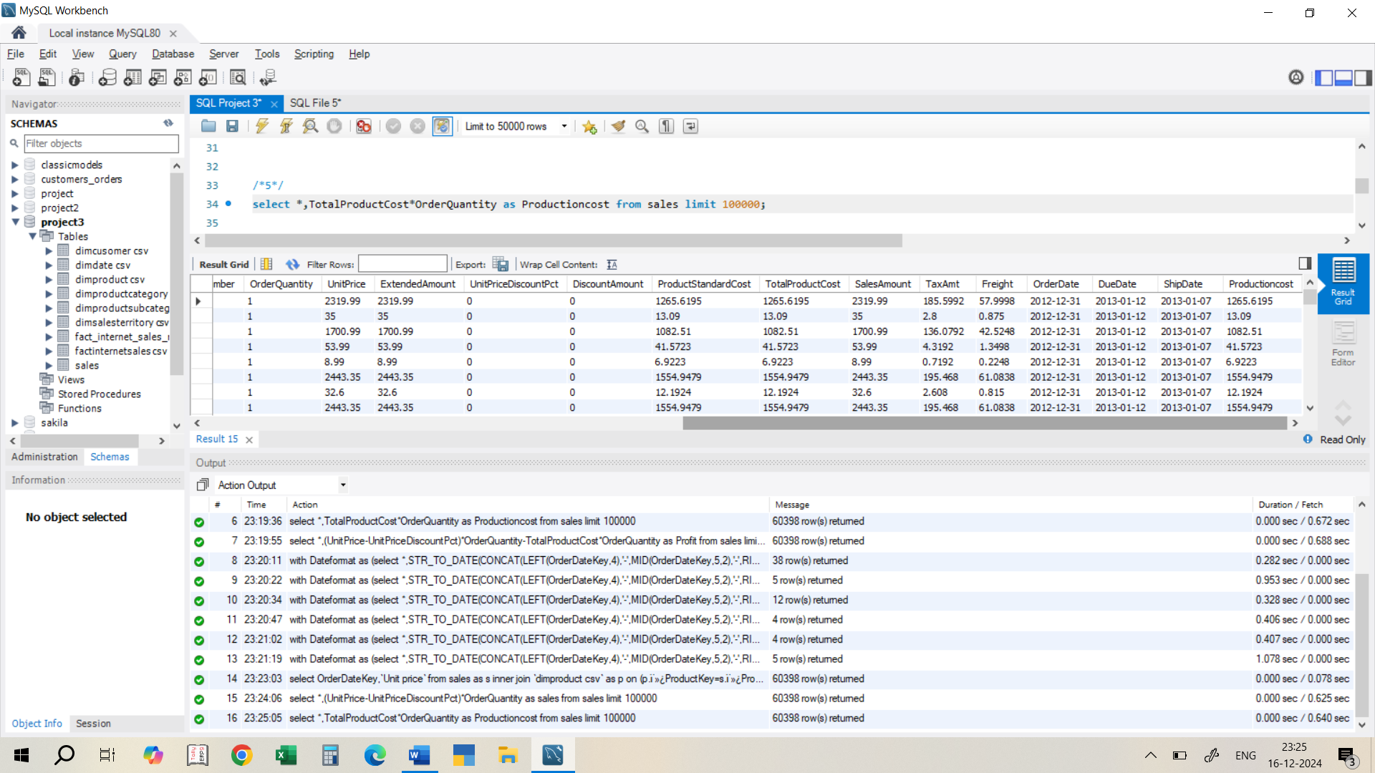
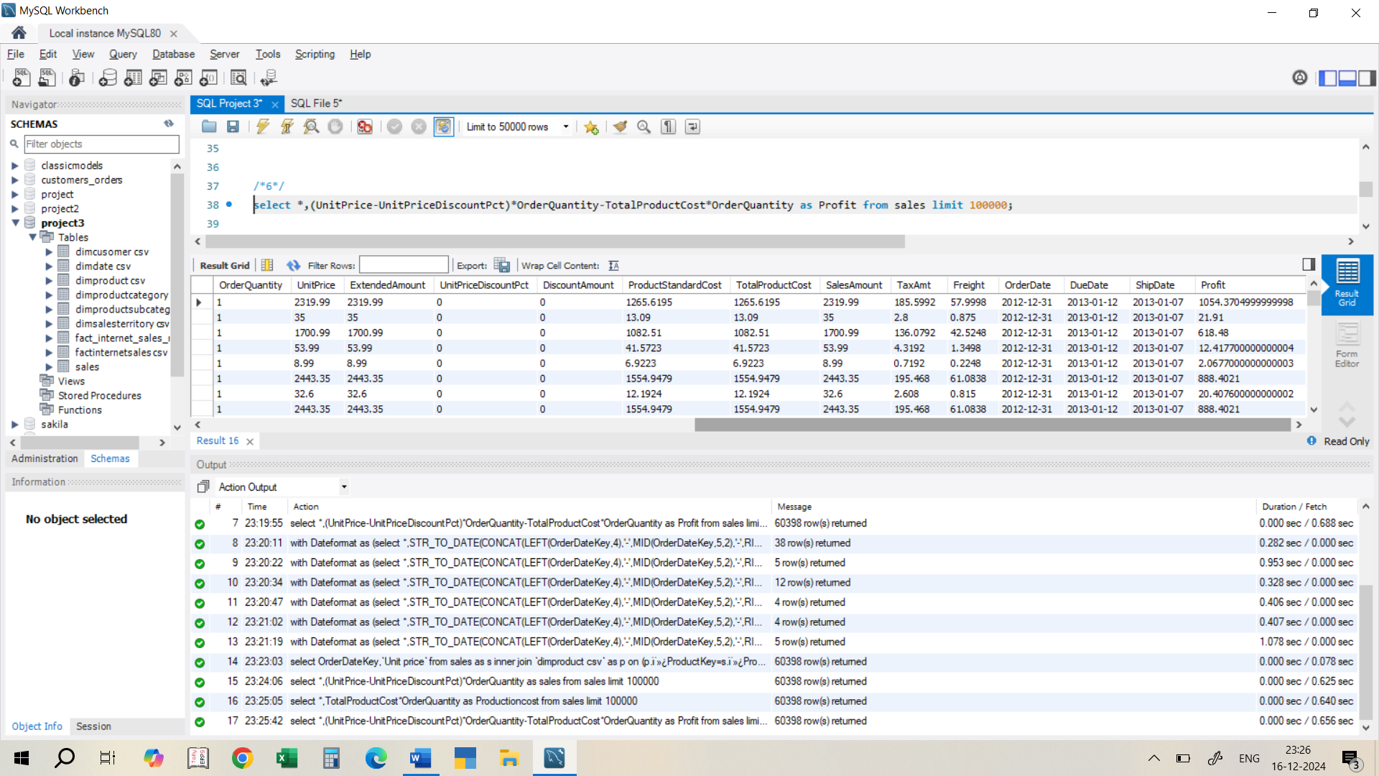
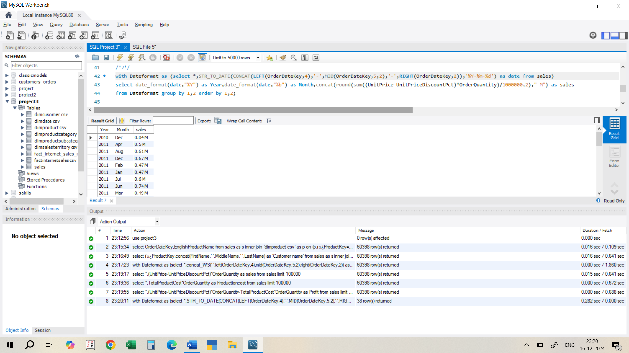
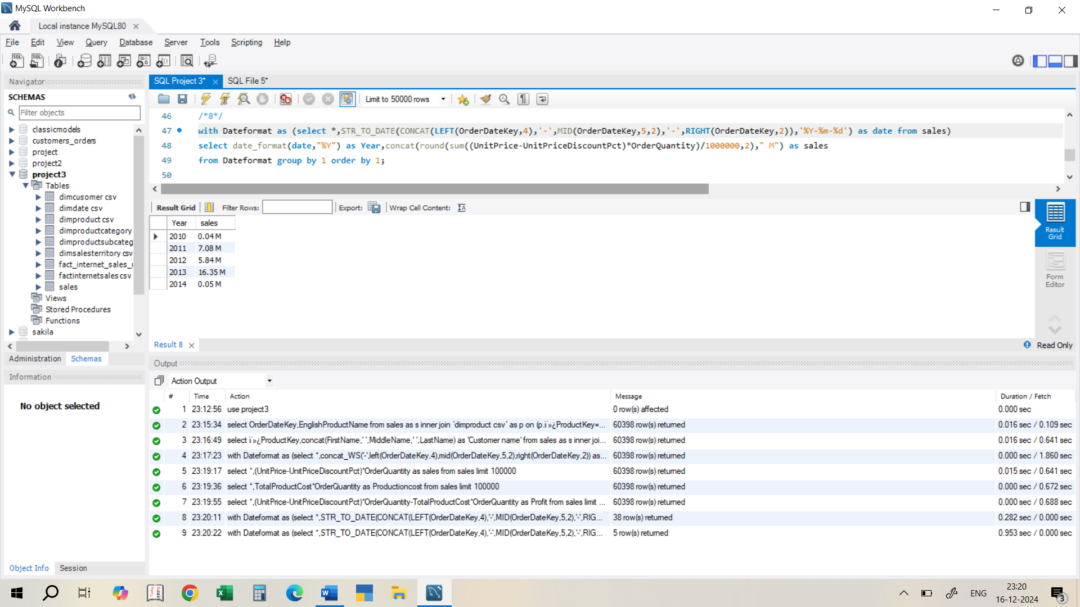
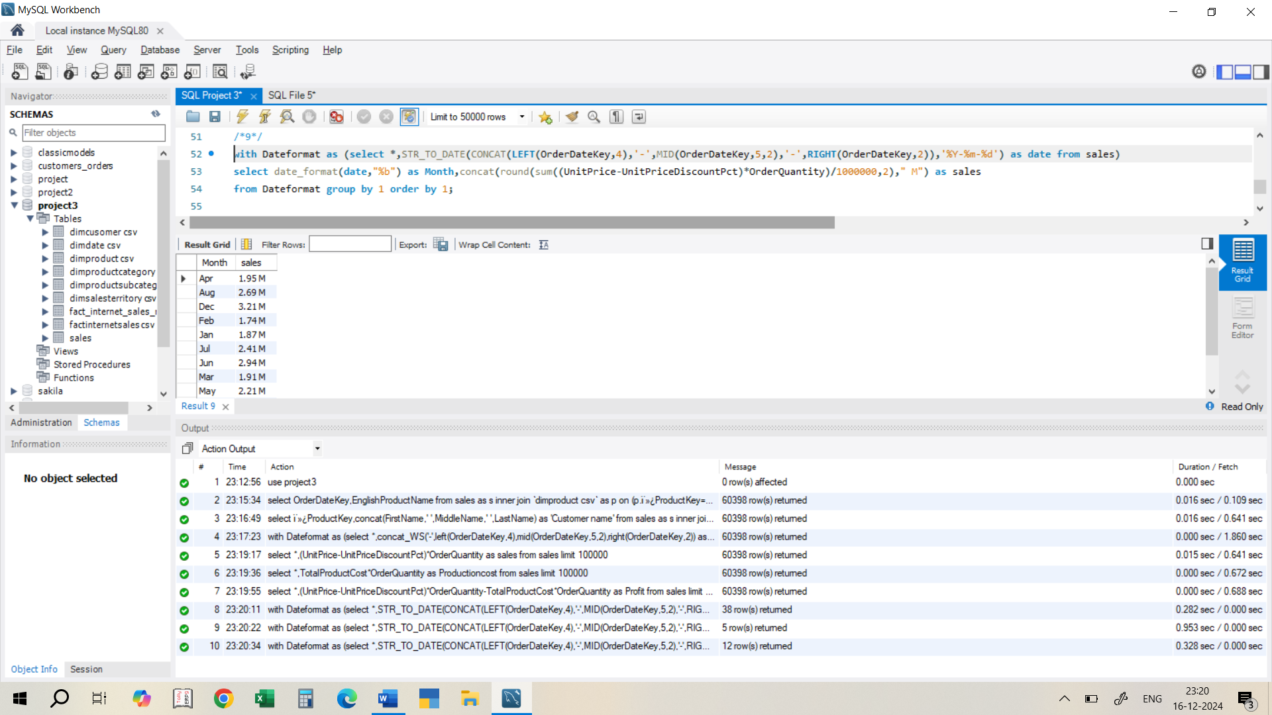
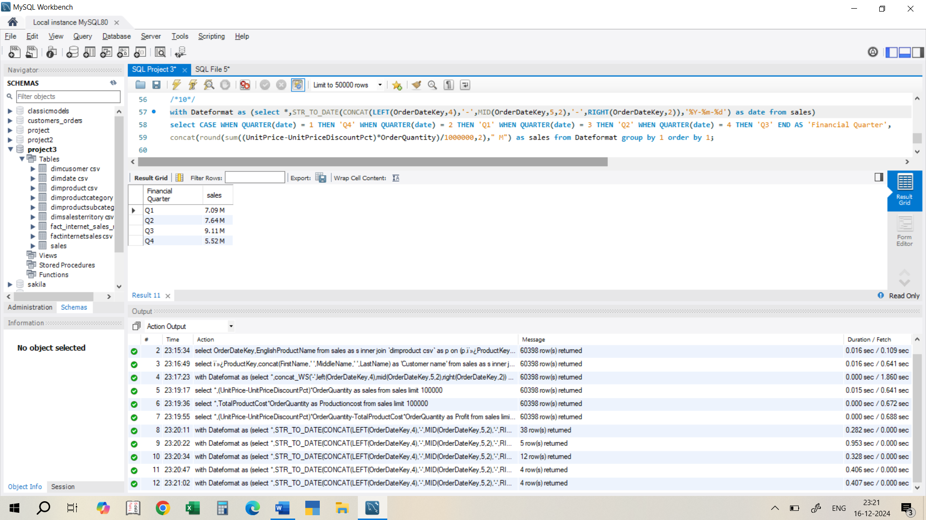
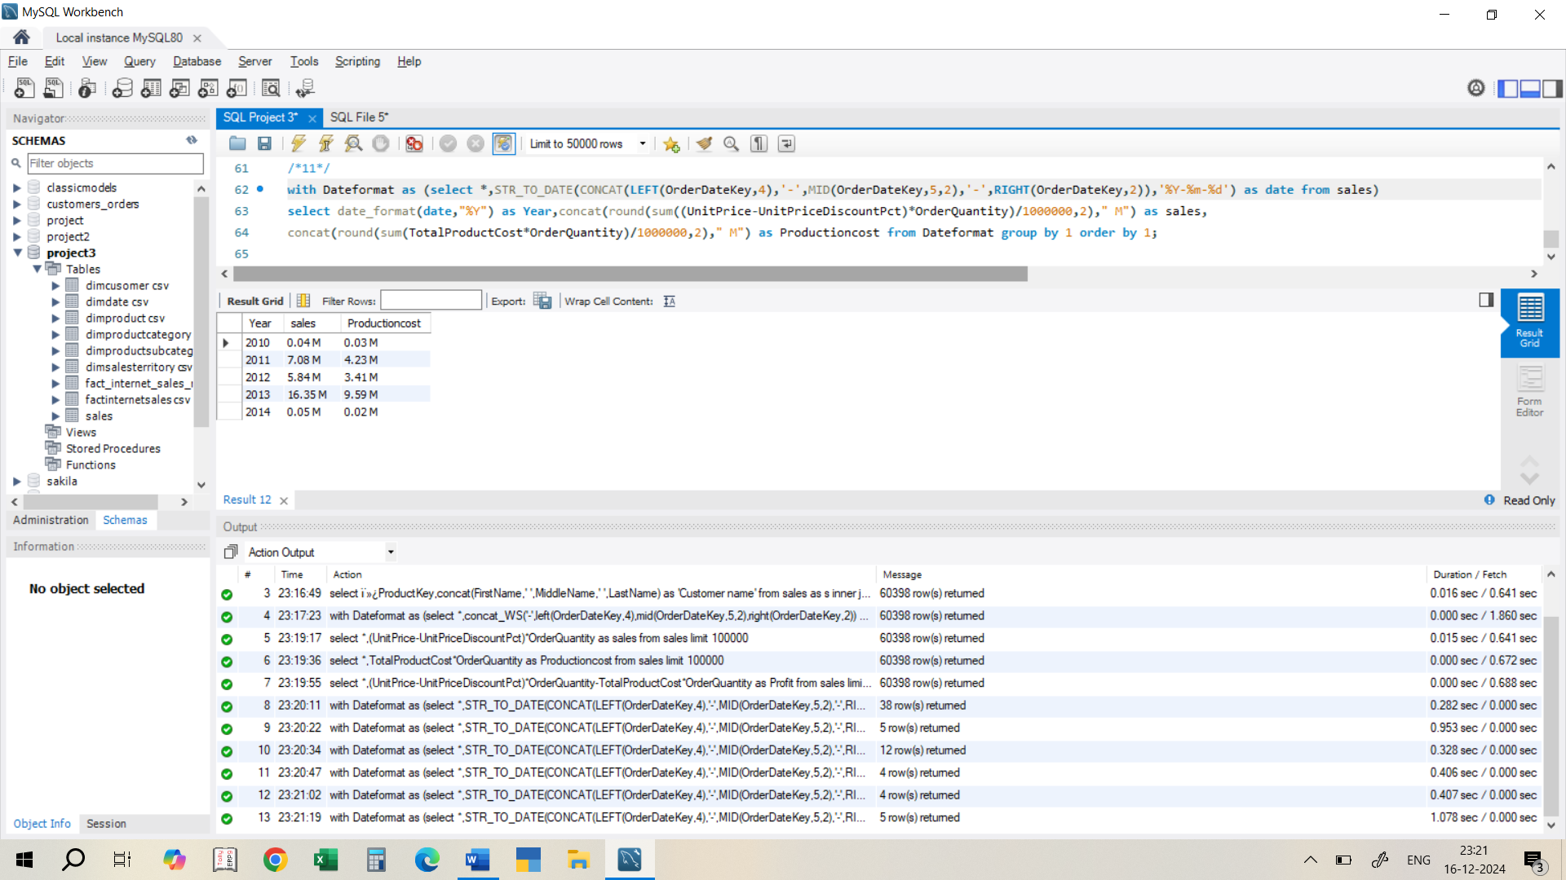
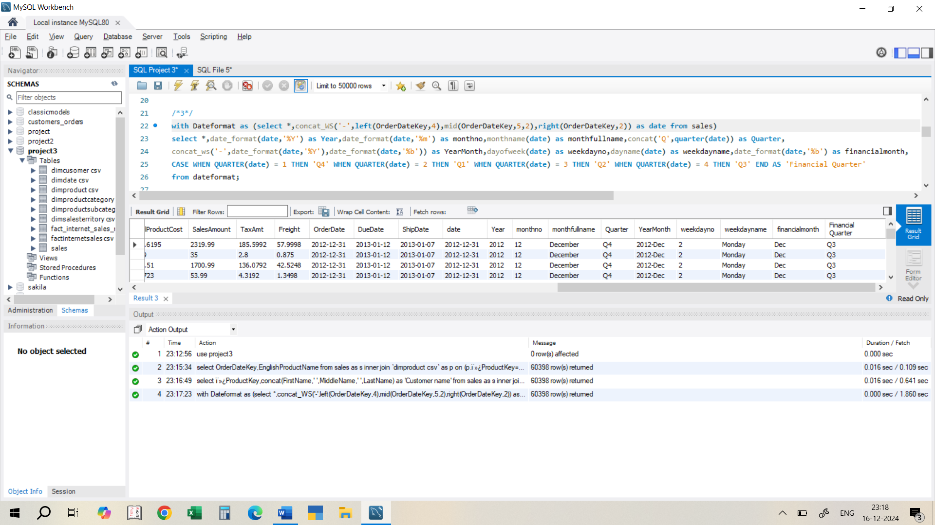
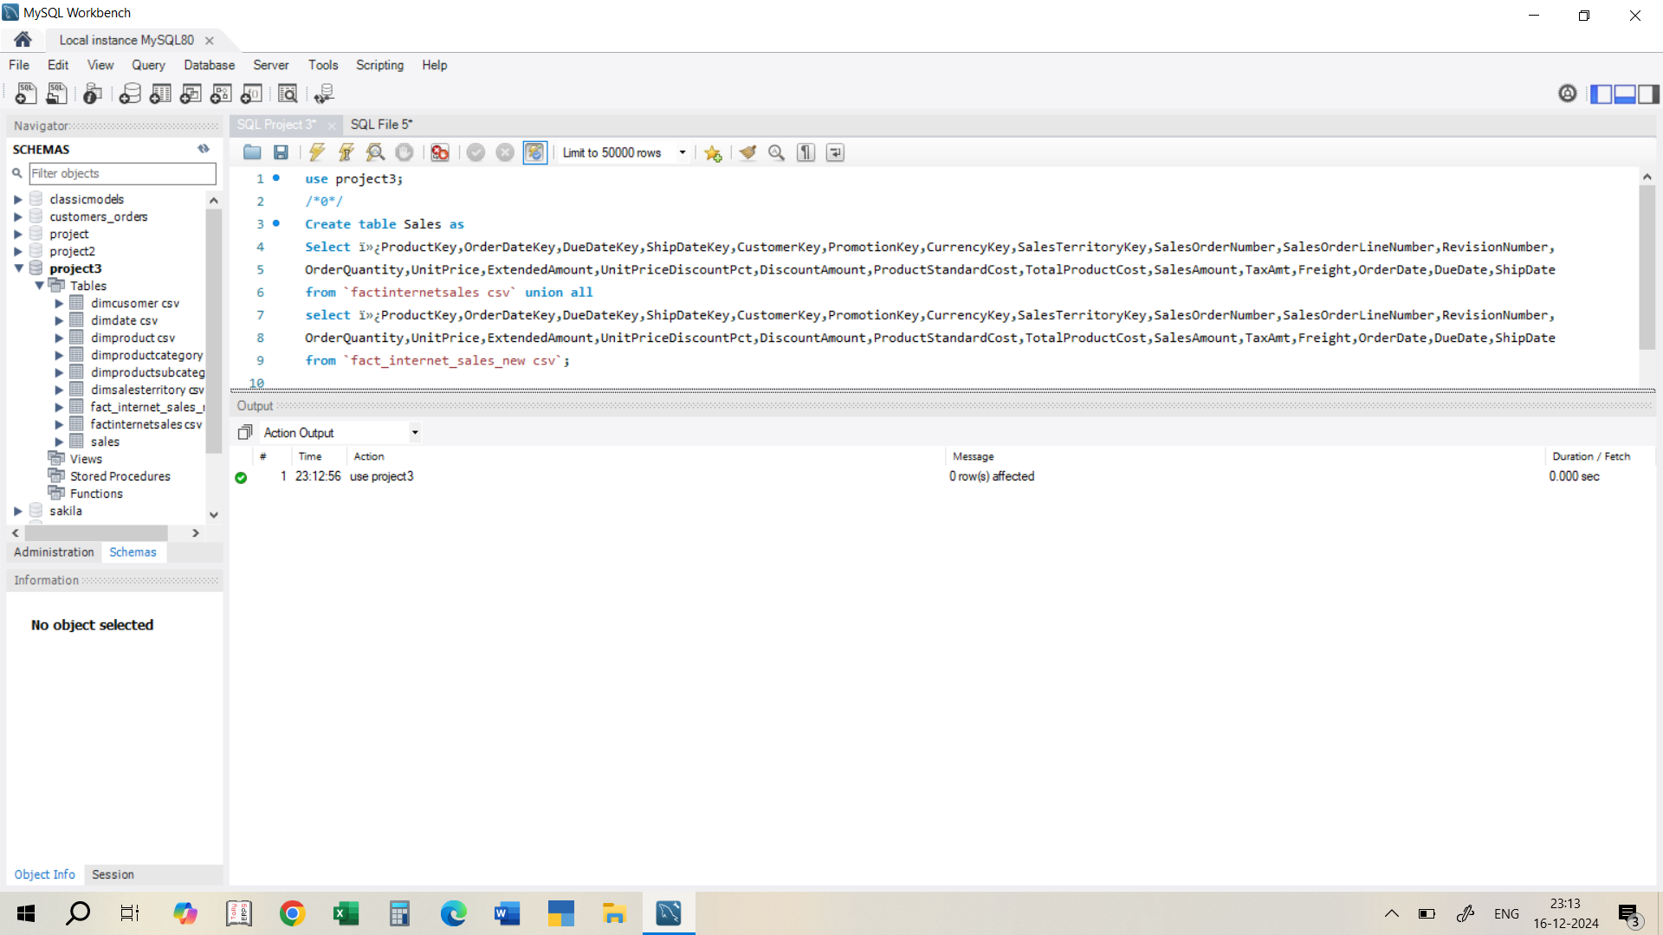
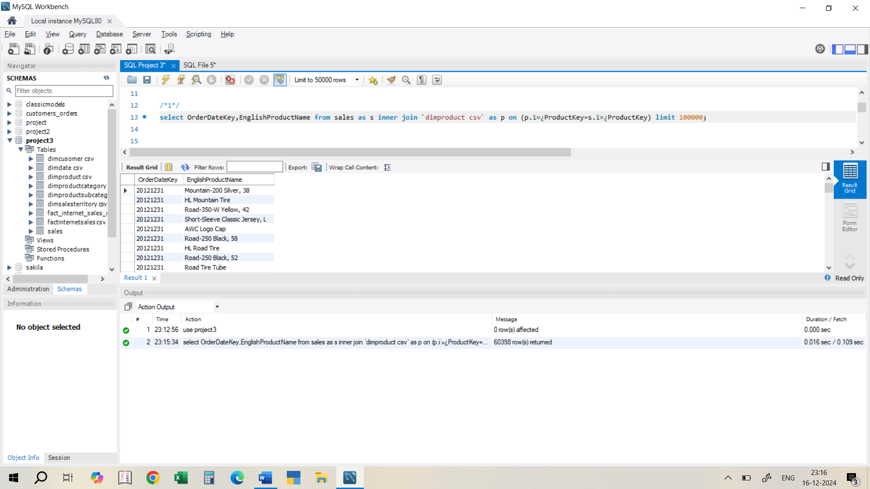
`
1
1
1
1
0
1
2a
2b
3
4
5
6
7
8
9
10
11

Slide 15
STRATEGIES RECOMMENDED
Focus on High-Performing Regions
Capitalize on Q4 Trends
Optimize Costs
2
4
1
3
5
Boost Low-Performing Regions
Address Off-Season Decline

Slide 16


